Slide 1
NT 21

Slide 2
Week 1 : Introduction (Networks, Layered Model, Linux) Week 2 : IP Protocol, IP Addressing, IP Subnets , ARP, Netkit Week 3 : IP Routing, ICMP Week 4 : TCP/UDP Week 5 : Sockets Week 6 : NAT, DHCP, DNS Week 7 : Repetition
Program

Slide 3
Layered Communication: TCP/IP Protocols Overview
Application Layer
HTTP
DNS
FTP
DHCP
DHCP
Telnet
SMTP
Sockets
Transport Layer
TCP
UDP
Network Layer
IP
DataLink Layer
Ethernet
Wifi
Bluetooth
Physical Layer
Ethernet
Wifi
Bluetooth

Slide 4
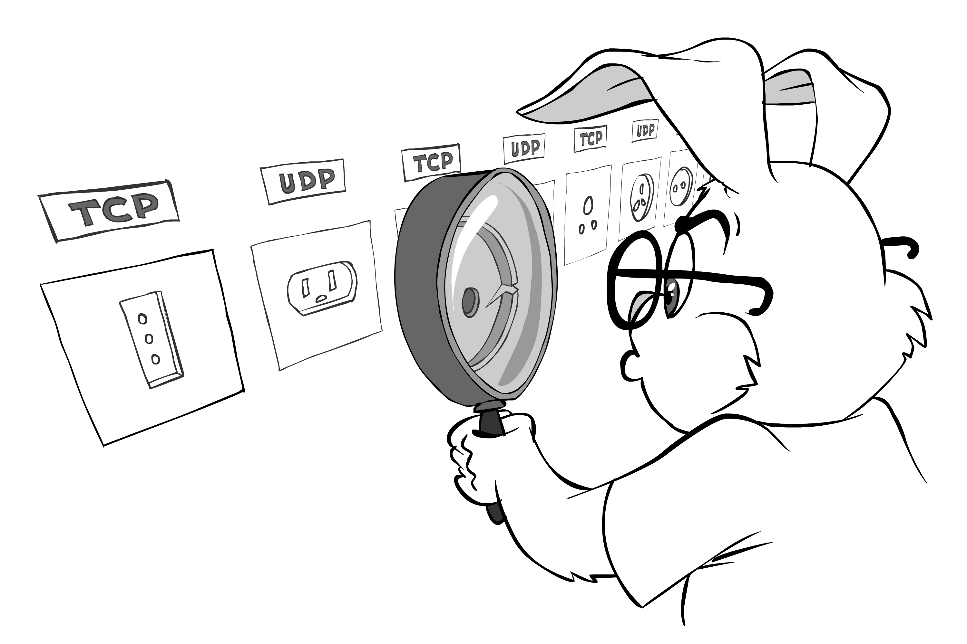
Sockets
Socket is an endpoint in a communication flow between two programs (typically client and server) running over a network

Slide 5


Sockets
Client Process
Server
Process
socket
socket
socket
Internet

Slide 6
Sockets TCP Socket Flow Chart
Client Process
Sever
Process
Create socket
socket()
socket()
Create socket
bind()
Bind socket to
a port
Send connect
to listening
server and
wait for
response
listen()
Socket ready to accept
connections
connect()
accept()
Client socket accepted and
ready to send/receive data
Send data
sendto()
receivefrom()
Receive data
receivefrom()
sendto()
Send data
Receive data
Close socket
close()
close()
Close socket

Slide 7
Sockets UDP Socket Flow Chart
Client Process
Sever
Process
Create socket
socket()
socket()
Create socket
bind()
Bind socket to
a port
Send data
sendto()
receivefrom()
Receive data
receivefrom()
sendto()
Send data
Receive data
Close socket
close()
close()
Close socket

Slide 8
Sockets API overview
socket() creates a new socket of a certain socket type, identified by an integer number, and allocates system resources to it.
bind() is typically used on the server side, and associates a socket with a socket address structure, i.e. a specified local port number and IP address.
listen() is used on the server side, and causes a bound TCP socket to enter listening state.
connect() is used on the client side, and assigns a free local port number to a socket. In case of a TCP socket, it causes an attempt to establish a new TCP connection.
accept() is used on the server side. It accepts a received incoming attempt to create a new TCP connection from the remote client, and creates a new socket associated with the socket address pair of this connection.
send() and recv(), or write() and read(), or sendto() and recvfrom(), are used for sending and receiving data to/from a remote socket.
close() causes the system to release resources allocated to a socket. In case of TCP, the connection is terminated.
gethostbyname() and gethostbyaddr() are used to resolve host names and addresses. IPv4 only.
select() is used to suspend, waiting for one or more of a provided list of sockets to be ready to read, ready to write, or that have errors.
poll() is used to check on the state of a socket in a set of sockets. The set can be tested to see if any socket can be written to, read from or if an error occurred.
getsockopt() is used to retrieve the current value of a particular socket option for the specified socket.
setsockopt() is used to set a particular socket option for the specified socket.

Slide 9
Sockets in C#
.NET framework provides API for Winsock (Windows Sockets API)
Socket class similar to original C (Berkeley/POSIX) sockets, rather low level
TCPListener, TCPClient, … are higher level classes, these are wrappers around Socket class, which provide easier use but less flexibility : these are used in assignment

